Slide 1
NACLO Prep: Round 2
Notes:
This is the second lecture in a series meant to be a mini prep course for the North American Computational Linguistics Olympiad.

Slide 2
Number Problems!
Task: figure out number system, solve equations in language x
Typical structure: given numbers in order/scrambled order in English and language x (sometimes also language y), asked to match them up and translate various numbers
General strategy: try to figure out the base (can be tricky!), use convenient facts about 0 and 1 (e.g. x to the power of y cannot be 0, y = 1 if xy = x)
Make counts of how often each number appears, use logic
Notes:
Basically paraphrase the slide, introducing number problems

Slide 3
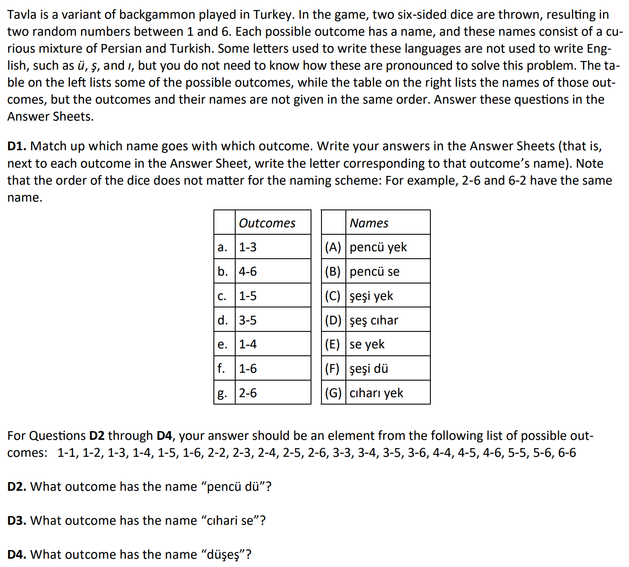
Example Problem
Number | Frequency
1 | 4
2 | 1
3 | 2
4 | 2
5 | 2
6 | 3
Word
yek
E
D
A
dü
B
se
G
C
cıhar(ı)
F
pencü
şeş(i)
2-5
3-4
6-6
Notes:
So here’s an example problem involving a Turkish backgammon game and its outcomes. We’re given a table of outcomes and a table of names, and they’re in scrambled order. So when we see scrambled order, we immediately try to apply some of the strategies from the chaos-and-order problem that we did last week. The biggest strategy is to look for words, or in this case, numbers, that are repeated a unique number of times, making note of the fact that as it says, a-b and b-a are the same. Strategy guide:
Make a table of how often each number appears, click
So we see that 1 appears 4 times, and the only word that appears 4 times is “yek”, so we know that 1 = yek, click
Then, 2 is the only number that appears once, and we see that there are several words that appear once: there’s şeş, dü, cıharı, and cıhar. With that in mind, let’s try using another fact, which is that 2 goes with 6, and 6 appears 3 times. So that immediately rules out şeş and cıhar, which each only appear once and appear in the same phrase. Looking at dü, we see that şeşi appears twice, but then şeş looks pretty similar to şeşi, so maybe şeşi represents 6 but can have different suffixes. And looking at cıharı, it only appears with yek, which we know is 1, so 2 has to be dü. Click
So then, we can match up g and F, click, and then knowing that 1 is yek and that şeşi has to be 6, click, we can match f with C, click.
Now, let’s try to match up all the outcomes that contain 1. So 1 appears with 3, 4, and 5, which are either pencü, se, or cıharı. Now they all appear twice, so that doesn’t really help, but it does tell us that cıhar must be the same thing as cıharı, and maybe it’s different when it comes second instead of first. Now, if we look at cıharı, we see that cıhar appears with şeş, which is 6, and we have a 4-6 but not a 3-6 or a 5-6, so cıharı must be 4, click, and we can match b with D, click, and then e with G, click, since 4 only appears twice.
Now, we know that 3 and 5 could be pencü or se. Looking at A, B, and E, they could literally go either way, so we can’t quite figure them out yet. So we can say that d goes with B because either way, those two have to represent 3 and 5. But then how do we figure out the last two? Well, let’s see--we remember that the problem says that 2-6 and 6-2 have the same translation--but how do they decide whether to say 2 then 6 or 6 then 2? They have to have a rule, which is either big number then small number or small number then big number. Looking at the ones we’ve already figured out, we see that 4-6 is 6-4, 1-4 is 4-1, 1-6 is 6-1, and 2-6 is 6-2, so it must be that the bigger number comes first. So then, looking at pencü se in B, knowing that they have to be 5-3 or 3-5, we can conclude that it has to be 5-3, so pencü is 5, and se is 3, and then we can match up the rest. Click.
Now, using our table, it’s easy to answer question 2, click. Looking at question 3, the i at the end of the first word might throw you off, but based on the info given in the problem, we aren’t allowed to write “impossible”, and so it must be 3-4. Click.
Question 4 is a little tricky. We’ve never seen a one-word outcome before, and if we parse it, it goes 2-6, but 2-6 already has a translation that was F in the table. So this is a bit of a jump, but it turns out that the only other sensible choice is that this represents “two sixes”, which would be 6-6, click.

Slide 4
Calendar/System Problems
Task: figure out a calendar system or a map system or some other system
Typical structure: given examples & slight explanation of how the system works, maybe some starting clues
General strategy: use the starting clues, employ all the strategies from writing system problems & translation problems
Notes:
Paraphrase slide

Slide 5
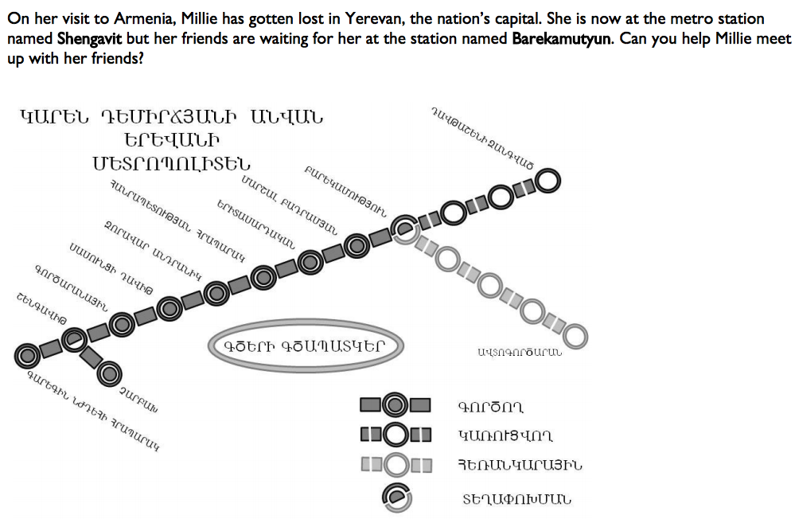
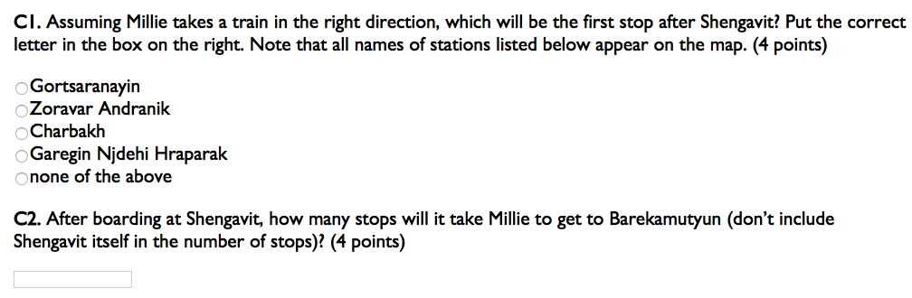
Example
8
Notes:
Solution guide:
It says that all the names of stations appear on the map, and there is only one three-word station, which must be Garegin Njdehi Hraparak. Our approach will be to find Shengavit and then find Barekamutyun, and then figure out how to get between the two.
Determining left to right: first character and fifth character of leftmost word are the same, so that character must be “g”, and so it must be left to right.
Last character of Garegin is n (corroborated by first character of second word), so make note of that
Sixth character of Garegin is “i”
Second character is a, fourth character is e, third character is r
Using this information, look for the stations that contain the g character: topmost, second from left on top row, leftmost on top row
Leftmost on top row is Shengavit, click, because it contains the a character right after the g character.
Second character in “Shengavit” is e, so “sh” must be the first character.
Last character in Shengavit is “t”, so to find barekamutyun, we look for the stations with “n” as the last character & that contain a twice, e once, and t
Only one that fits the bill is the second one from the top/right, click
So in the right direction, she would have to go to the station that’s 2nd from left in the top row, click, which would be Gortsaranayin because it’s the only choice that starts with “g” and is one word, click
Question 2 is easy, we just count the number of stops from starting point to destination, which would be 8
*might help to write these things out on the board if you have a whiteboard*

Slide 6
Computational/Formal Problems
Task: lots of different varieties, usually revolves around walking through a machine algorithm
Neural networks, translation system
Typical structure: explanation of how the system works, gives some examples/clues
General Strategy: try to use algebra & logic; not really a general way to solve all such problems
These problems can sometimes be really long, so might help to skim before trying to crack the code

Slide 7
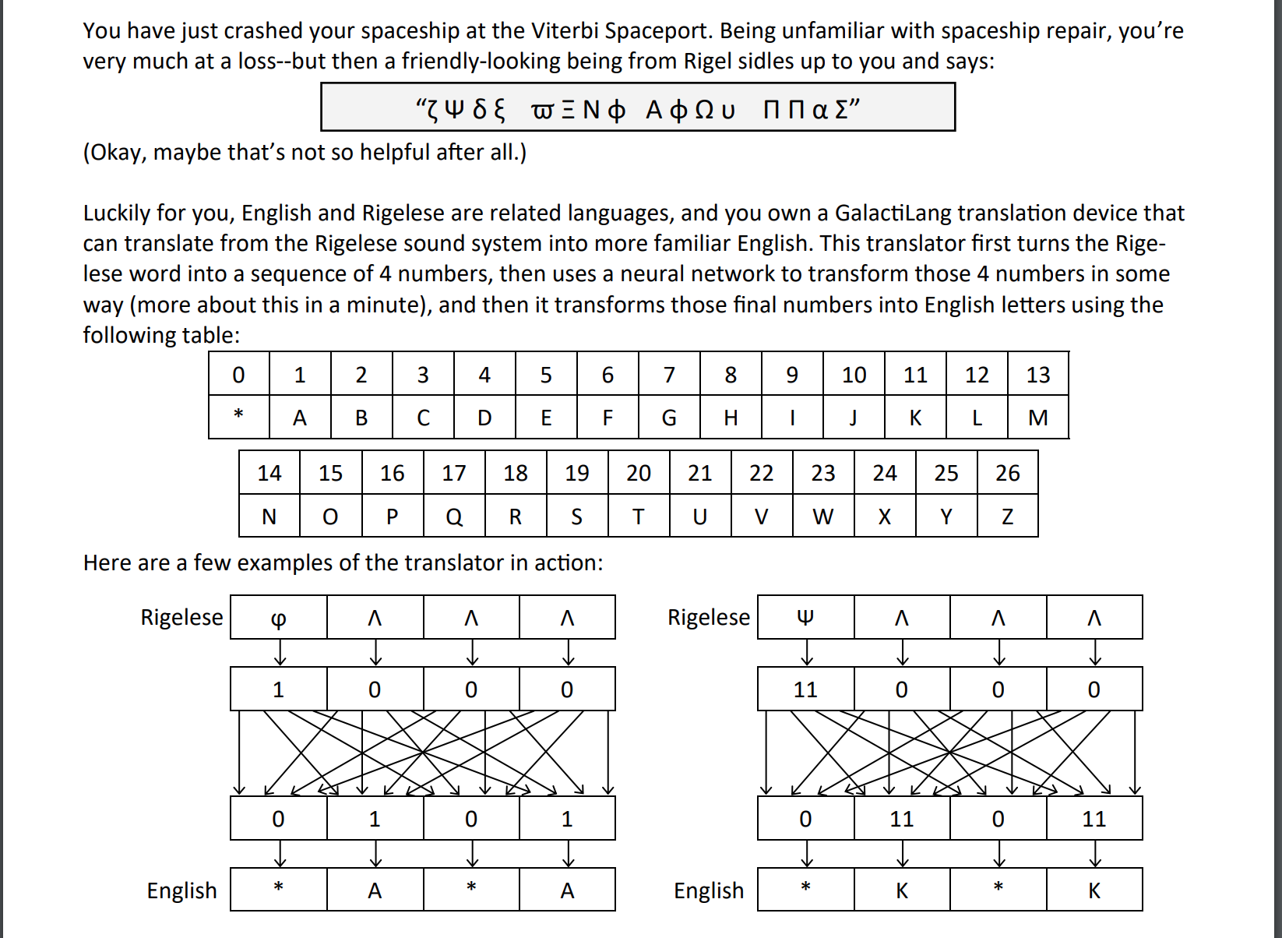
Example
Notes:
So here’s an example problem statement. You have some strange space language called Rigelese, and you have this cryptic message at the top here. Then, it gives you a conversion system between English letters and numbers, because neural networks can only process numbers, not plain text. And after that, it gives you some examples of some phrases in the cryptic language that are processed through this neural network and spit out these English translations at the bottom.

Slide 8
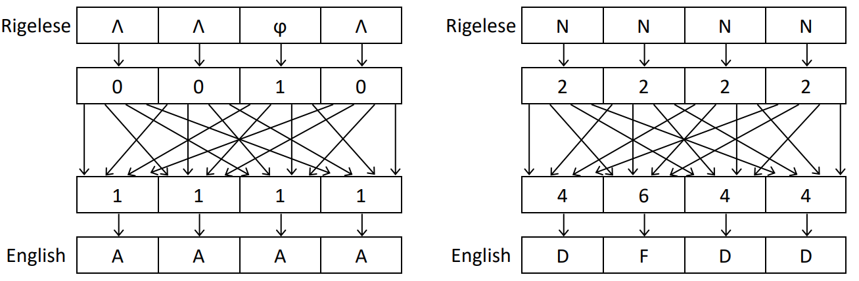
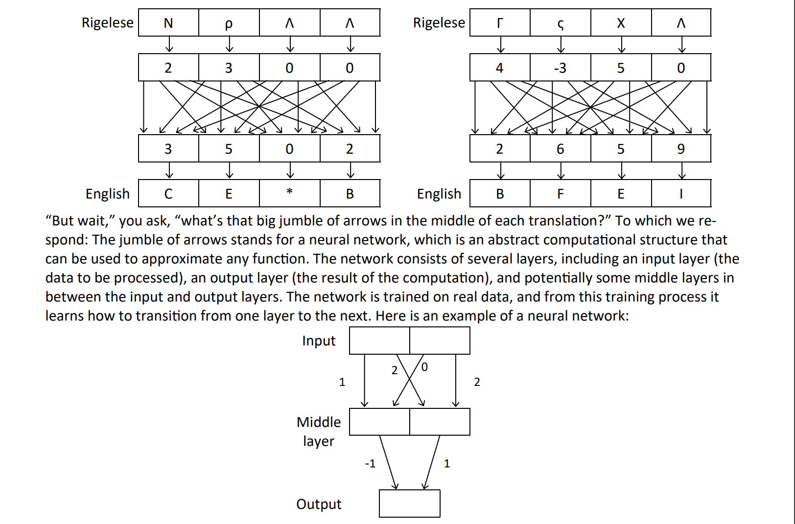
Notes:
Here are some more examples that we’re gonna use...

Slide 9
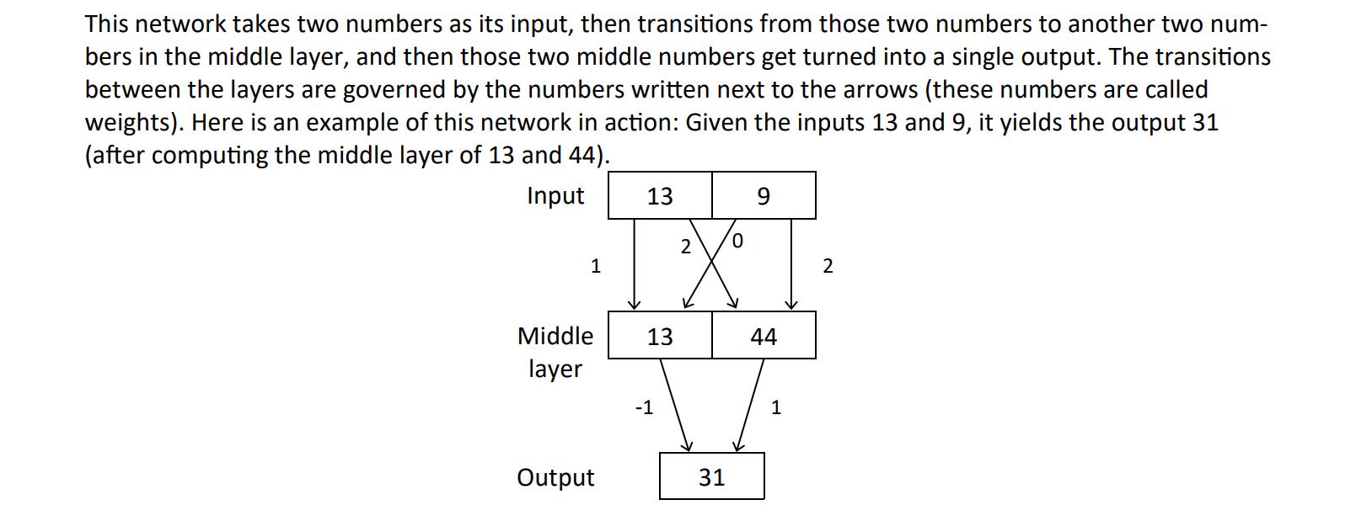
Notes:
And here, it’s explaining how the jumble of arrows, which is the neural network, works. So as you can see, the Rigelese is first converted into numbers representing the characters. And then, each of these arrows has a real number weight, and you add up the products of the weights and the inputs, to get each value in the middle layer. And then, you pass the middle layer values through another function to get the final output. So in our example at the bottom, the left cell of the middle layer is equal to 13*1 + 9 * 0, which is 13, and the right side is 9 *2 + 13 * 2, which is 44. Then, the output is equal to 13*-1 + 44*1, which comes out to be 31.

Slide 10
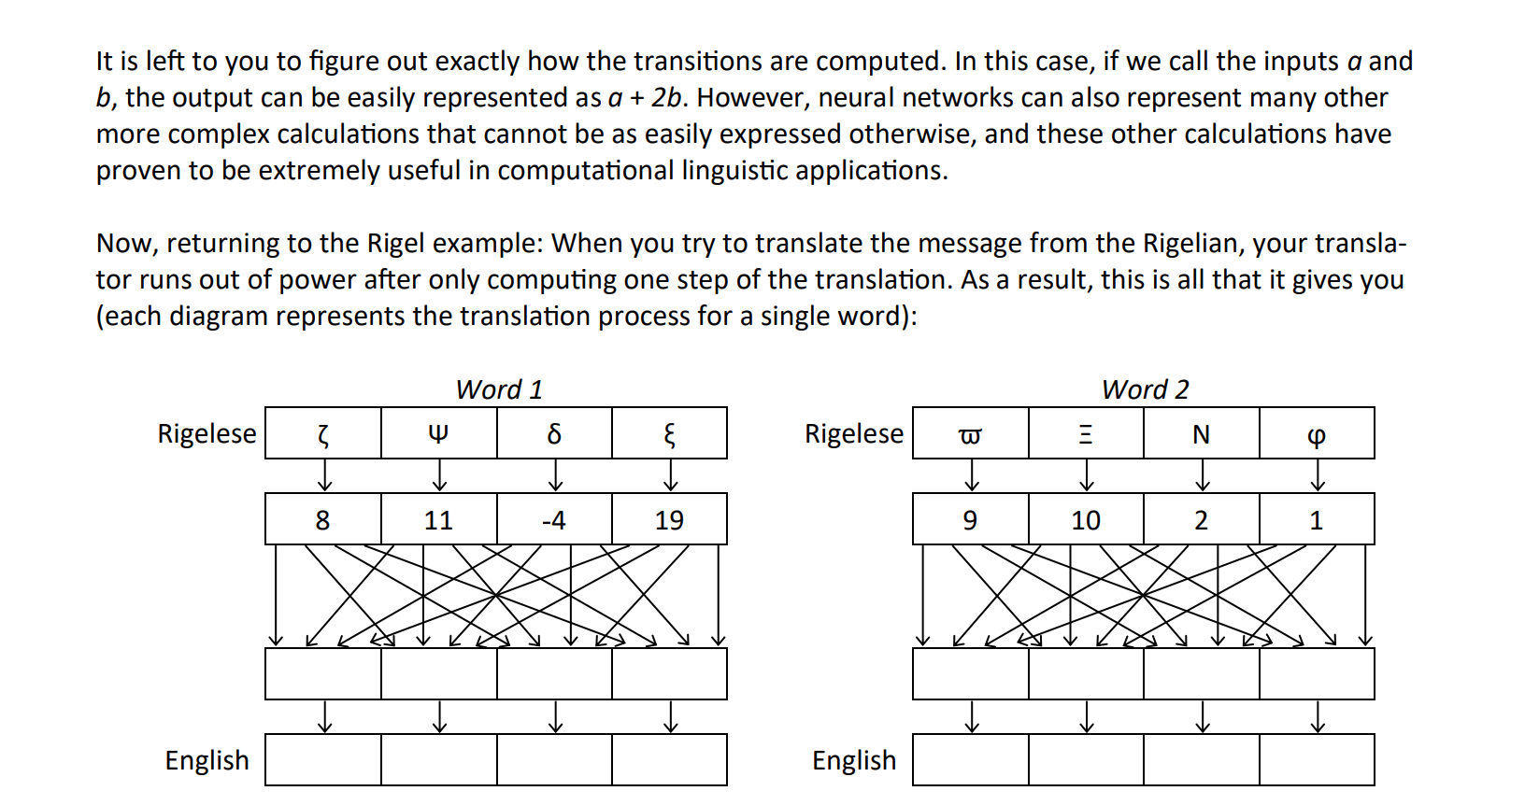
Notes:
So here’s what they’re asking us to do. They give us the Rigelese letters, and then they give us the numbers they correspond to, and then they have the jumble of arrows with the same weights they gave us in the examples, and from there we have to figure out the weigh on each arrow, from which we then figure out the four numbers that then map to four English letters. *ask for potential strategies*

Slide 11
Solution: System of Equations!
2W₁₁+ 3W₂₁+ 0W₃₁+ 0W₄₁ = 3
2W₁₂+ 3W₂₂+ 0W₃₂+ 0W₄₂ = 5
2W₁₃+ 3W₂₃+ 0W₃₃+ 0W₄₃ = 0
2W₁₄+ 3W₂₄+ 0W₃₄+ 0W₄₄ = 2
Repeat using the other examples
W₁₁
W₂₁
W₃₁
W₄₁
Notes:
Ok so the answer in this case is that we use pretty simple algebra--it’s going to turn out to be a simple system of equations. So in this example here, we’re labeling the weight from the ith cell in the top layer to the jth cell in the middle layer as W sub ij, and as one example, we see that 2 times this weight plus 3 times this weight, plus 0 times these weights must be equal to 3. And then we repeat the process for the other middle layer cells, and we repeat that whole process on the other example data to get 4 systems of 4 equations each. And so, as some of you might have learned in Algebra II, each system can be solved using a matrix--so essentially, the computer does a bunch of matrix computations to figure out what the weights are. And as mentioned, these calculations from layer one to layer two aren’t always straightforward linear calculations, but the basic idea is that the computer makes some sort of a matrix and computes the weights and functions for each branch. And then, in this case, there’s no activation function, but if there were to be an activation function, we humans would pick it and sort of heuristically try to see which combo of functions works best.

Slide 12
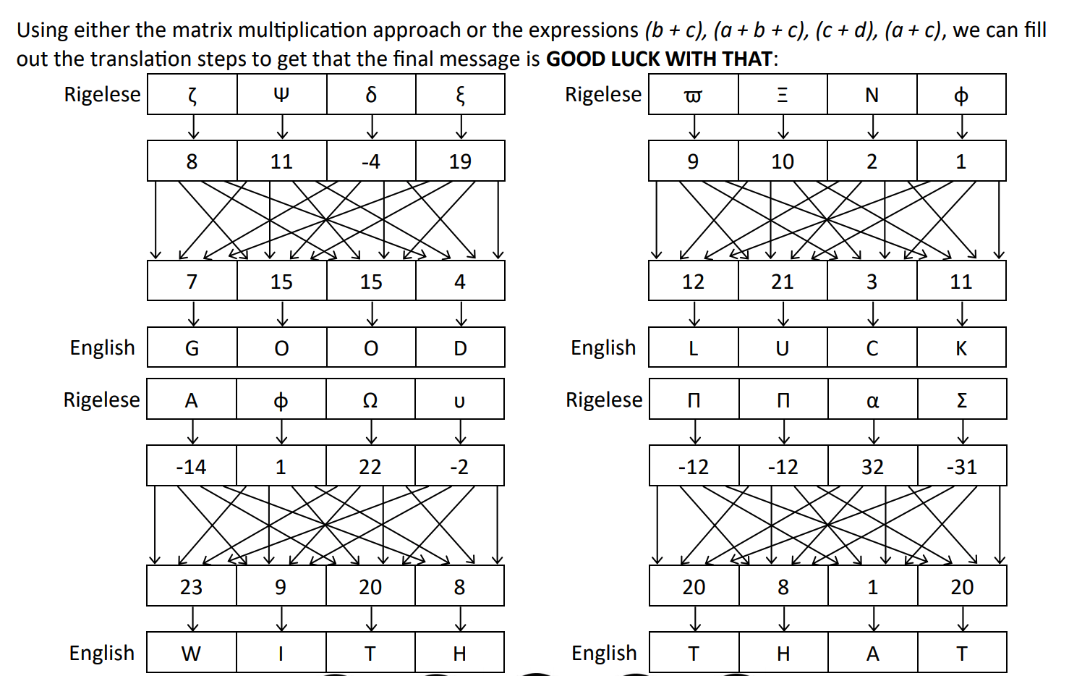
Answers
Notes:
*show these after giving them some time to work out the problem*
*go back to slide 5 while they work on the problem*

